Slide 1
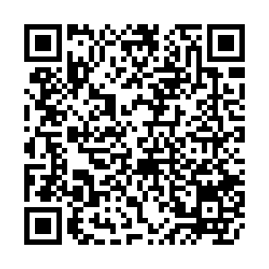
Lecture 01: Welcome, Coding Environment, Functions, and Exceptions I
CS 61A SU26
June 22, 2026
Rebecca Dang
Join pollev.com/rebeccadang831 (or scan QR code) on your phone or laptop
We’ll begin at Berkeley time (10 minutes after), as per tradition!

Slide 2
Welcome
Introductions
Pre-semester survey
About the course
Course materials
Syllabus, logistics, and support
Questions or concerns? Here’s how to let us know
AI
If time:
  Computing in the news
  What do you want to build?
30 min

Slide 3
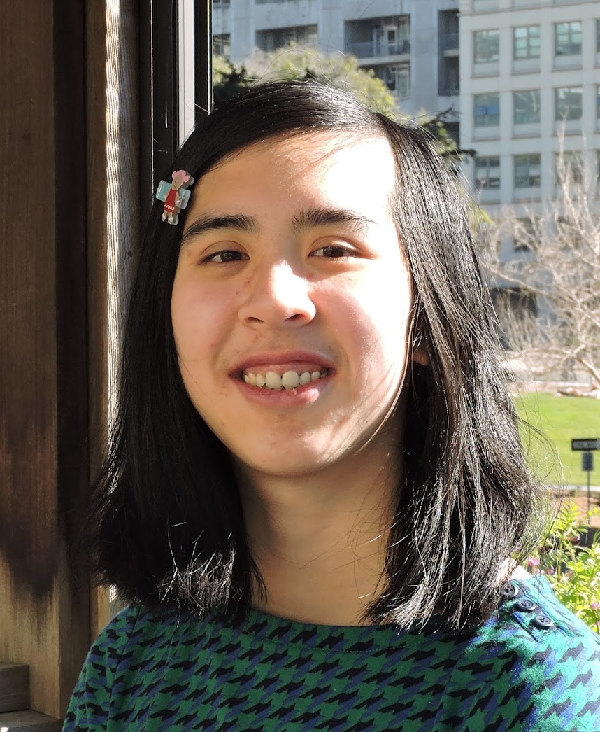
Introductions (1 of 2)
Hey there, I’m Rebecca (she/her)!
Education: Cal BS EECS ‘25, MS EECS ‘26 (go bears 🐻)
Teaching:
  DATA 188 (Intro to Deep Learning)
  DATA C88C (Computational Structures in Data Science) 5x
  DATA 101 (Data Engineering)
  CS 61A (teaching/academic intern)
  Computer Science Mentors 4x (volunteer tutoring)
Professional (all SWE internships):
  Databricks (also incoming full-time)
  Stripe
  Bloomberg 2x
Hobbies/interests: Watching movies/TV shows, reading, hiking, plushies
Website: phrdang.github.io

Slide 4










TAs!

Slide 5










Tutors!

Slide 6
Introductions (2 of 2)
Turn to someone next to you and introduce yourselves!
Name
Year
Major
1 thing you’re excited about this summer
1 thing you’re nervous about this summer

Slide 7
go.cs61a.org/presem
Please fill out our pre-semester survey!
(Part of Lab 0, so might as well do it now)

Slide 8
About the course
CS 61A: The Structure and Interpretation of Computer Programs
You will learn 3 programming languages: Python, Scheme, and SQL
… but this is not just an introductory programming course
Key ideas: Abstraction, problem solving, managing complexity, and interpreting programming languages
… in other words, how to think like a computer scientist
How to succeed? (see also: Advice from past students)
Attend and actively participate in all synchronous parts of the course (lecture, lab, discussion)
Do the assignments yourself and come to OH/ask questions on Ed/talk to classmates if you get stuck (productive struggle)
Exams: Do problems from past exams
Notes:
"Confusion is the sweat of learning" -UC Berkeley professor (Prof. Satish Rao maybe?)

Slide 9
Course Materials
(Almost) everything is on our course website, cs61a.org
Lecture recordings: bCourses > Media Gallery (~1 day delay)
Q&A: edstem.org
Submitting assignments: Gradescope
Textbook: Composing Programs
IMPORTANT: You are solely responsible for knowing the syllabus/course policies, assignment deadlines, and checking your email and Ed for announcements.
Today’s lecture is NOT comprehensive of everything you need to know.

Slide 10
Syllabus, logistics, and support (1 of 3)
Syllabus: cs61a.org/articles/about-61a/
New this summer:
  We are 100% in-person (decision from the chairs)
  Weekly Computer-Based Testing Facility (CBTF) quizzes
    Why? Frequent, small-stakes testing > single high-stakes test
  Grading policy: ⅔ exams, ⅓ everything else
    Why? AI coding tools make take-home assignments a noisy signal of students’ understanding and skill
New since our welcome Ed announcement:
  61a-bot enabled on HW
  Orientation quiz release date moved to Tue 6/23

Slide 11
Syllabus, logistics, and support (2 of 3)
OH: cs61a.org/office-hours/ (calendar may change, check before going)
DSP accommodations: Please submit your letter of accommodation ASAP
Lab/discussion excused absence requests: Email cs61a@berkeley.edu
Extensions: Submit request on go.cs61a.org/extensions (Flextensions)
Coming soon: Exam prep tutoring sections
Notes:
Explain what OH and DSP are

Slide 12
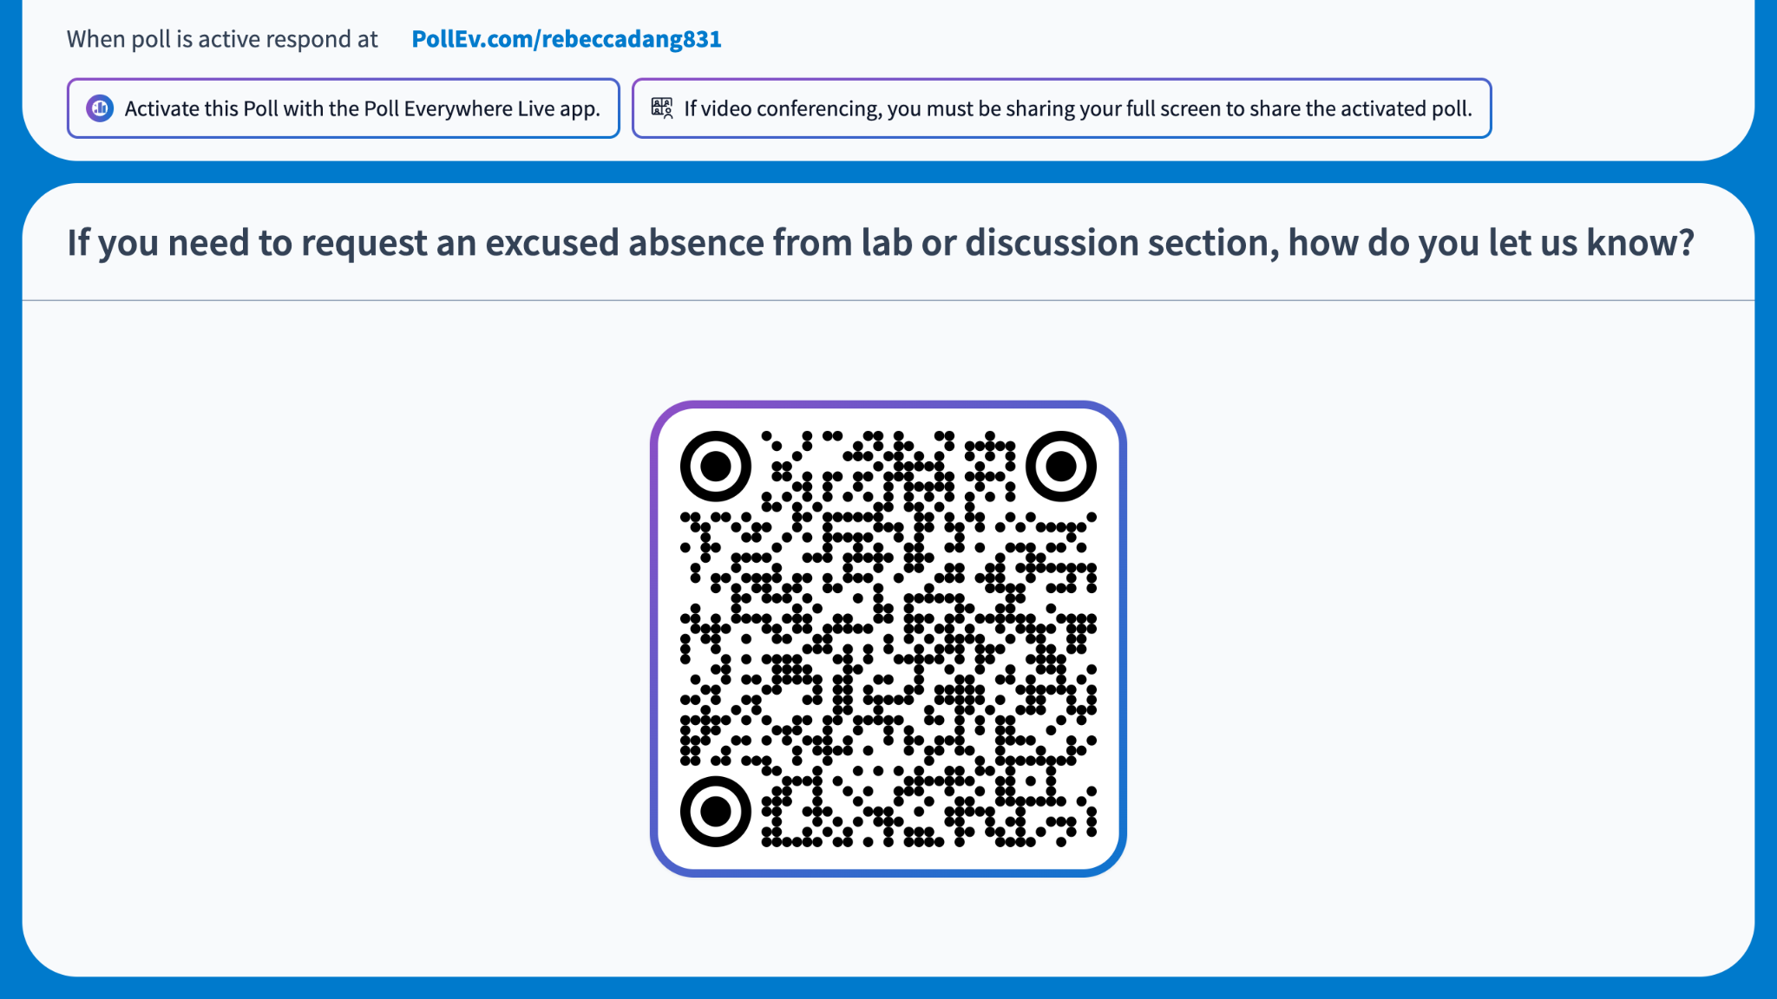
Notes:
Respond: https://PollEv.com/multiple_choice_polls/tA5eXLjCDU1Mjck08oueJ/respond
If you need to request an excused absence from lab or discussion section, how do you let us know?
Email your lab/discussion TA
Email the instructor
Email cs61a@berkeley.edu
Make a private Ed post
Answer: (c)

Slide 13
Questions or concerns? Here’s how to let us know
Is your question about the course content or logistics? → Ed or OH
Are you requesting an extension? → Flextensions
Are you requesting an excused absence from lab/discussion? → cs61a@berkeley.edu
Is your question about DSP accommodations? → cs61a@berkeley.edu
Is your question about an extenuating circumstance or sensitive, but you’re okay with admin TAs and the instructor seeing it? → cs61a@berkeley.edu
Is your question only something that the instructor can answer or otherwise sensitive?
  Do you want to be anonymous?
    Yes → go.cs61a.org/anon-feedback
    No → rdang@berkeley.edu (me)

Slide 14
AI
Our course AI policy TLDR:
  Using AI to code for you ❌
  Using AI as a documentation or learning resource ✅
Why?
  Yes, we know AI coding tools are widely used on the job today
    But do you want to be the person who mindlessly vibecodes all day?
    Do you want to be reliant on a corporation (which cares more about profit than you) for your thinking and skills?
    How can you judge that AI output is good and correct without knowing at least the fundamentals?
  Critical thinking, problem solving, design, communication, etc. are still important skills.
  At the end of the day, you as the engineer are accountable for all AI outputs

Slide 15

Notes:
scratch creator: “do we want to teach our kids how to play the piano or play the stereo?”
forklift analogy
french dictionary vs french poetry; “code taste”
answers are in the back of the book

Slide 16
If time: Computing in the news
Note: All computing in the news sections are not in scope for exams, but great to know about as a person!
In Age of AI, World’s Leading Deepfake Expert No Longer Trusts His Own Eyes (New York Times)
  Featuring former UC Berkeley Professor Hany Farid
Failing grades soar as professors see greater AI usage, dwindling math skills in UC Berkeley computer science classes (Daily Cal)
Anthropic Pulls Its Most Powerful AI Models After U.S. Bars Foreign Access (TIME Magazine)

Slide 17
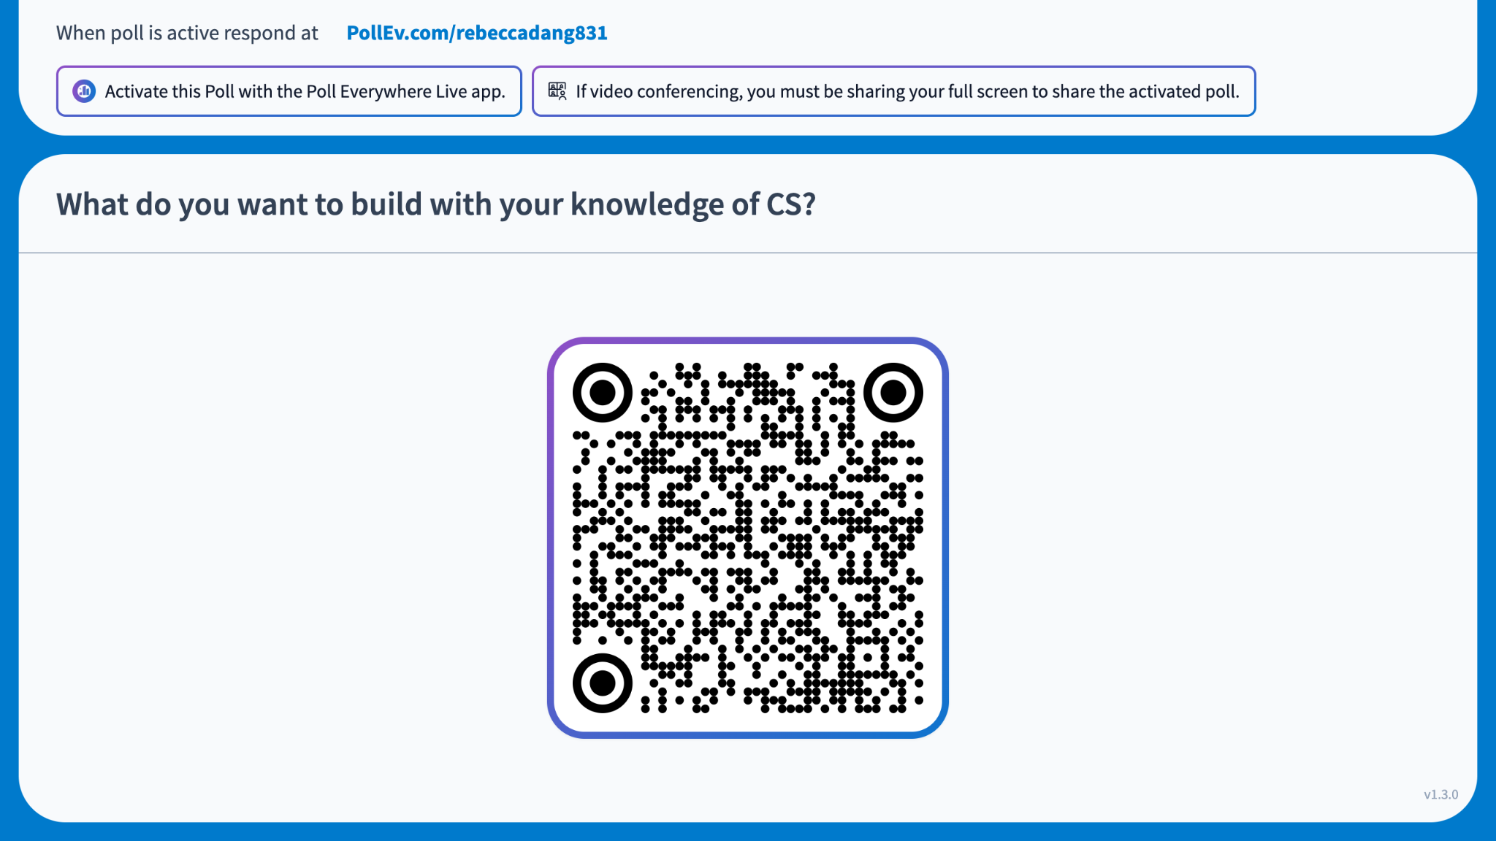
Notes:
Respond asynchronously: https://PollEv.com/free_text_polls/vUoBziL5cRqLQYRopo5yP/respond
What do you want to build with your knowledge of CS?
(free response word cloud, no correct/wrong answer)

Slide 18
Coding Environment
File System
Terminal
Python Interpreter
10 min

Slide 19
File System
File
Directory (folder)
Path: Location of a file or directory
  Absolute: Your full address
  Relative: "I'm living at the apartment 3 blocks north of here"

Slide 20
Demo: Terminal
Command-line (text) based program to interact with your computer and file system
Demo (Unix/Mac/WSL)
  Parts of a terminal prompt
  Up/down arrow for command history
  pwd: print working directory
  ls: list files and directories
  cd: change directory
    cd .. → go to parent directory
    cd ~ → go to home directory
  touch: create a file
  mkdir: make directory
  rm: remove a file or directory (⚠️ danger!)
[out of scope] Customize your prompt with Starship

Slide 21
Demo: Python Interpreter
How to open: Install Python 3, then run python3
Terminal vs. Interpreter
  Terminal: Run commands
  Interpreter: Run Python code
How to exit: exit(), quit(), or Ctrl + D
Interpreter vs. IDEs (Visual Studio Code)
  Interpreter: Temporary, demoing code
  IDE (integrated development environment): Permanent, writing longer snippets of code (in a file), more features for software engineering

Slide 22
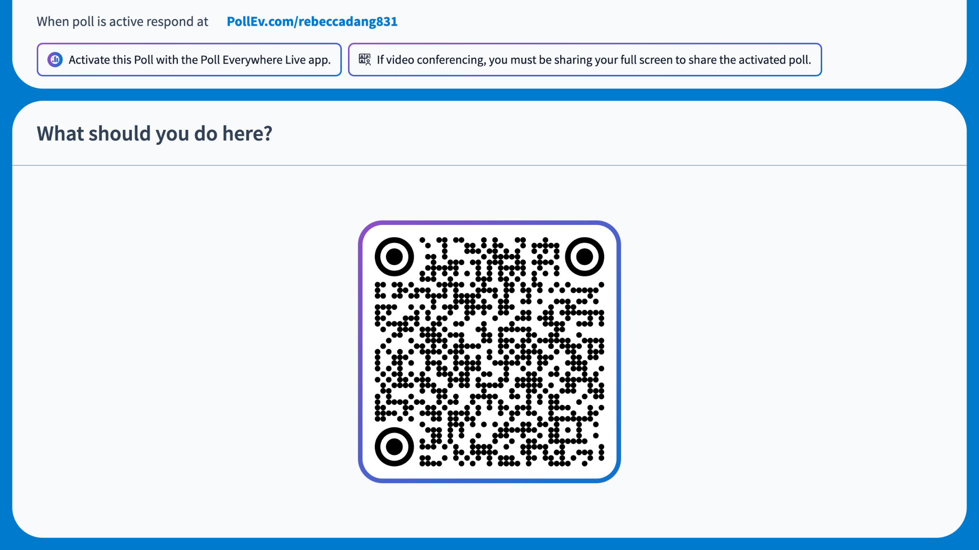
Notes:
https://PollEv.com/multiple_choice_polls/GIf90Z1qvotnDzwVsOOYj/respond
What should you do here?
>>> cs cs61a
File "<python-input-0>", line 1
cs cs61a
^^^^^
SyntaxError: invalid syntax
Exit the terminal
Exit the Python interpreter
Retry the same command
Use the ls command instead of cd
Answer: (b)

Slide 23
Functions
Primitive data types
Expressions
Names and Assignment
Functions
Print vs. Return
30 min

Slide 24
Primitive data types
Integer, ex: -5, 0, 100
Float, ex: -1.1, 0.0, 43.9235
String, ex: 'hello world' or "hello world"
  Multiline strings or comments: Triple single or double quotes
Boolean, ex: True or False

Slide 25
Demo: Expressions
Way to combine data types. Python automatically computes or evaluates expressions. # denotes a single line comment in Python.
>>> (2 + 2) * 5
20
>>> 5 ** 2 # exponent
25
>>> 10 / 3 # true division
3.3333333333333335
>>> 10 // 3 # floor division
3
>>> 10 % 3 # modulo operator
1
>>> 'hello'
'hello'
>>> 'hello' + 'world'
'helloworld'
>>> 'a' * 5
'aaaaa'
Notes:
Explain that weird floating point arithmetic is explained in CS 61C
Order of operations is PEMDAS

Slide 26
Demo: Names and assignment
What if we want to give a label to a particular value or save it for later use?
We can bind a value to a name (often called a variable, although names can be used for other things).
>>> pi = 3.1415926
>>> pi
3.1415926
>>> # multiple assignment
>>> x, y = 1, 3
>>> x
1
>>> y
3
>>> name = 'Rebecca'
>>> f'Hello {name}!' # f-string
'Hello Rebecca!'
>>> # import statement
>>> from operator import mul
>>> mul(10, 5)
50

Slide 27
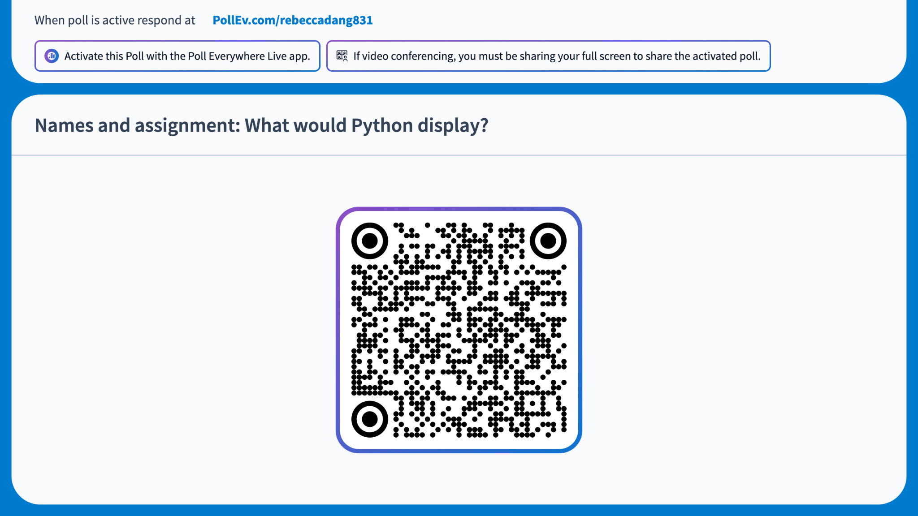
Notes:
https://PollEv.com/multiple_choice_polls/IiWLVV2YPqLUUOvOUUfRs/respond
Names and assignment: What would Python display?
>>> length = 5
>>> width = 10
>>> area = length * width
>>> area
50
>>> width = 20
>>> area
5
10
50
100
Answer: (c)

Slide 28
Demo: Functions (1 of 2)
What if we want to abstract away a set of operations so that we can reuse it? We can define our own functions!
A function can take 0 or more inputs or parameters, and return 1 or more outputs or return values.
The value you pass into a parameter is called an argument (e.g. below, 5 is the argument).
Calling (or using) a function involves a call expression: The function name and its argument(s) in parentheses, separated by commas.
>>> from math import pi
>>> def circle_area(radius):
… return pi * (radius ** 2)
>>> circle_area(5)
78.53981633974483

Slide 29
Demo: Functions (2 of 2)
def circle_area(radius: float = 1) -> float:
"""Returns the area of a circle
with the given radius.
>>> from math import pi
>>> circle_area()
3.141592653589793
>>> circle_area(5)
78.53981633974483
"""
return pi * (radius ** 2)
Functions can return multiple values separated by commas
  Technically, it's a single tuple, but we'll get to that later…
Functions can have default arguments
Type hints which tell the interpreter and programmer the data type of each parameter and return value
Docstrings are multiline strings right below the function signature that document the behavior of the function
  They may contain doctests, or code that show how the function is supposed to behave

Slide 30
Demo: Builtins
Python has several built-in functions you can use without importing.
>>> max(1, 2, 3)
3
>>> min(1, 2, 3)
1
>>> len('hello')
5
>>> sum(1, 2, 3)
6
>>> print('hello world')
hello world

Slide 31

Functions: Call expressions (1 of 2)
Call expression order of evaluation:
Evaluate the operator (does the function name exist?)
Evaluate the operands from left to right (simplify the arguments to a single value)
  You may need to do steps 1-3 recursively here! (see next slide)
Apply the operator to the operands (run the code in the body of the function)

Slide 32
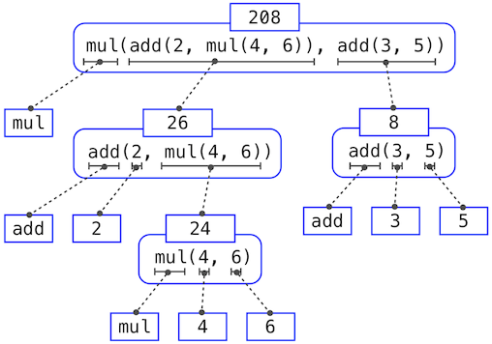
Functions: Call expressions (2 of 2)

Slide 33
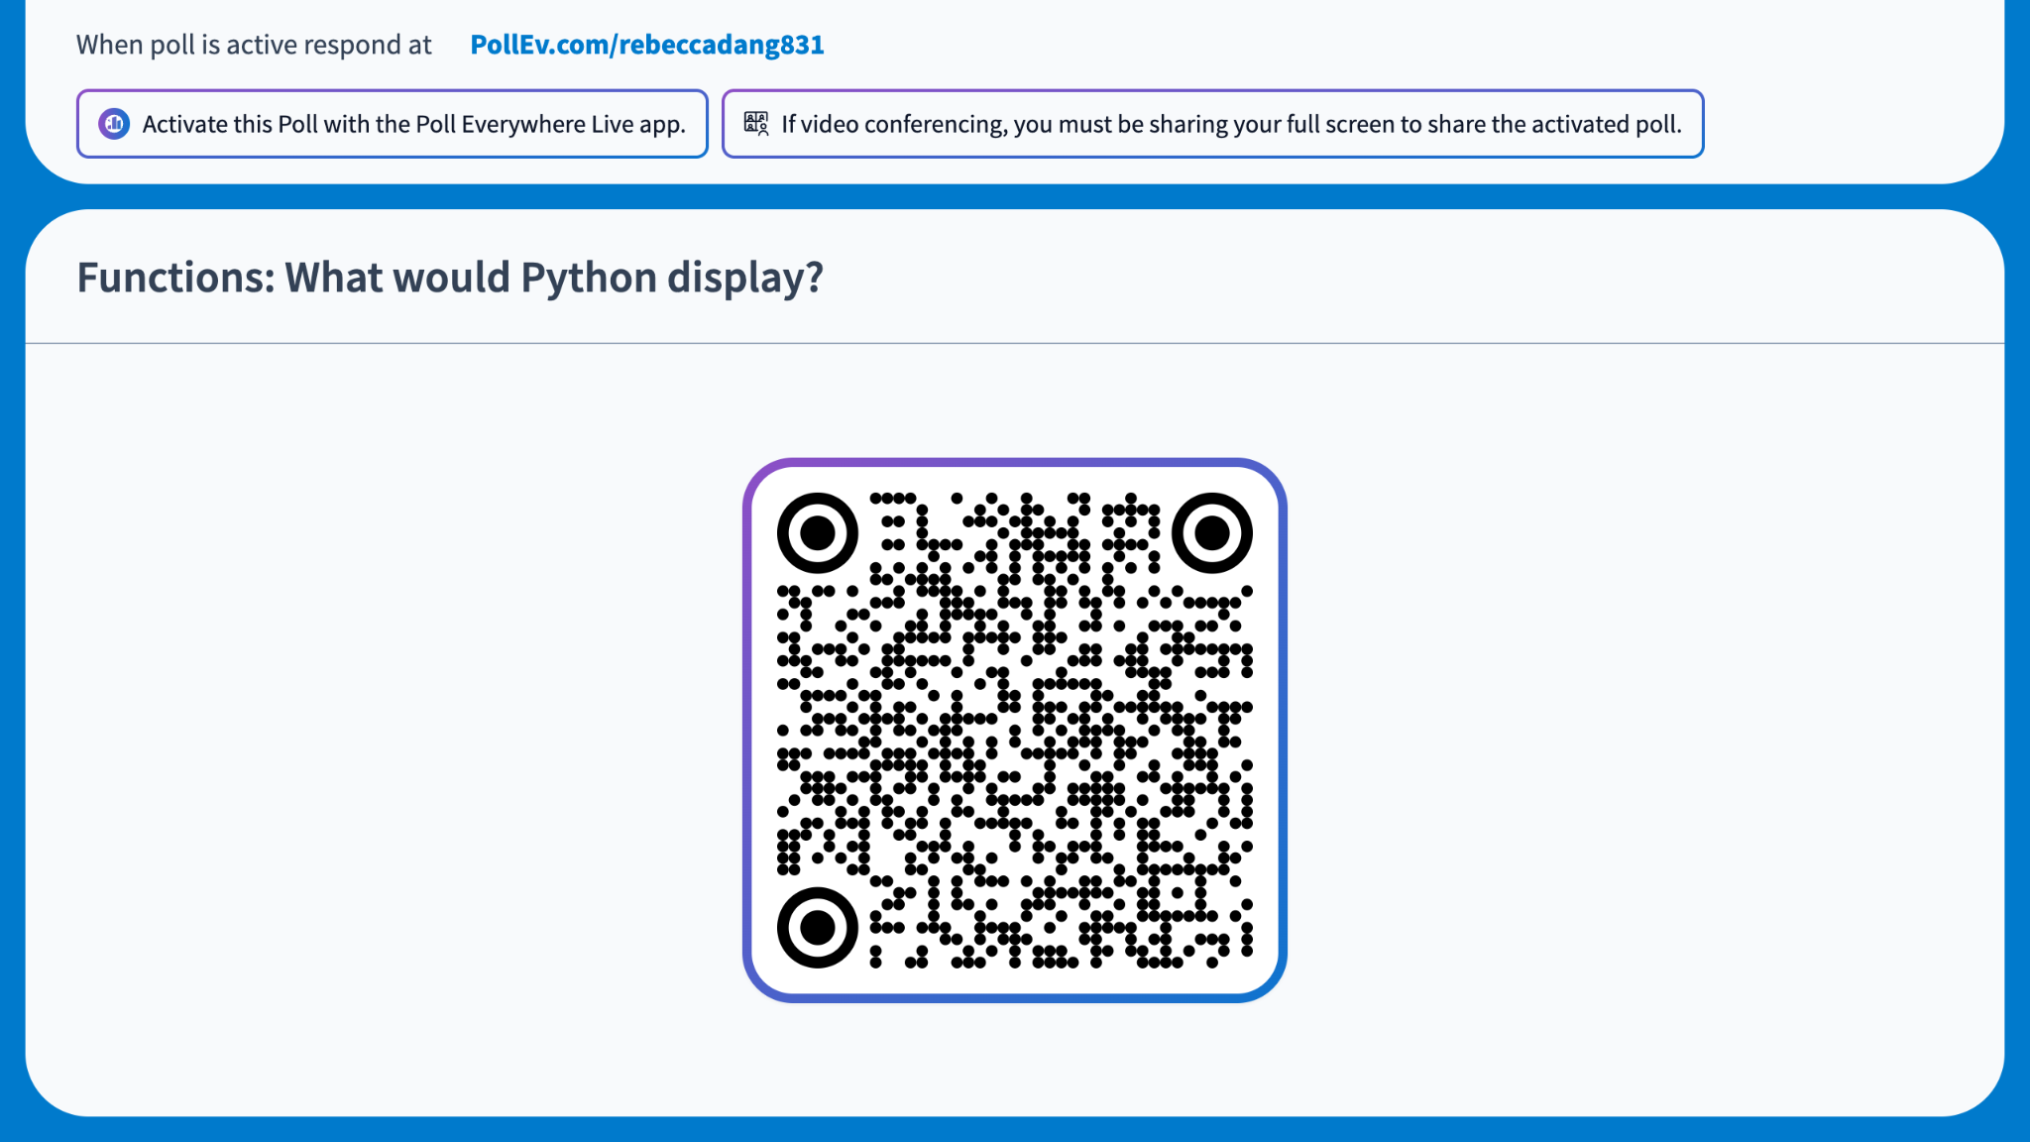
Notes:
https://PollEv.com/multiple_choice_polls/BZTJPiuHZG8GOpi3nKOWL/respond
Functions: What would Python display?
>>> f = max
>>> g = min
>>> f(2, g(5, 3), 4)
2
3
4
5
It would error
Answer: (c)
Permalink to environment diagram: https://pythontutor.com/cp/composingprograms.html#code=f%20%3D%20max%0Ag%20%3D%20min%0Af%282,%20g%285,%203%29,%204%29&cumulative=true&mode=edit&origin=composingprograms.js&py=3&rawInputLstJSON=%5B%5D

Slide 34
Print vs. Return
Use print if you want to display something
Use return if you want to actually compute something
Analogy: print is like if I have $5 and show you I have it. return is like I give you the $5 to use.
Pure vs. non-pure functions
  Pure functions only return a value, and given some input, it will always produce the same output
  Non-pure functions produce side effects, such as changing or mutating some data structure, or printing

Slide 35
None
What happens if you don't have a return statement?
  Your function will implicitly return None, a special value in Python that represents "nothing"
  print returns None
Note: The value None is not displayed by the Python interpreter unless it is explicitly printed!
>>> def square(x):
… x ** 2
>>> square(2)
>>> print(square(2))
None

Slide 36
Exceptions I
Exceptions
Reading a stack trace
Print debugging
Assert statements
10 min

Slide 37
Exceptions
When something goes wrong in a program, an exception (or error) occurs
  AKA "raised" or "thrown"
Types of errors, in increasing order of difficulty of debugging
  Syntax: "Illegal" Python code
  Runtime: Python code is legal, but does something that breaks the program as it's running
  Logical: Python code is legal and doesn't do anything that would break the program, but it produces output you didn't want

Slide 38
Exceptions: Syntax
>>> def square(x:
... return x * x
...
File "<python-input-21>", line 1
def square(x:
^
SyntaxError: '(' was never closed

Slide 39
Exceptions: Runtime
>>> def divide(a, b):
... return a / b
...
>>> divide(5, 0)
Traceback (most recent call last):
File "<python-input-23>", line 1, in <module>
divide(5, 0)
~~~~~~^^^^^^
File "<python-input-22>", line 2, in divide
return a / b
~~^~~
ZeroDivisionError: division by zero

Slide 40
Exceptions: Logical
>>> def square(x):
... return x * 2
...
>>> square(3)
6

Slide 41
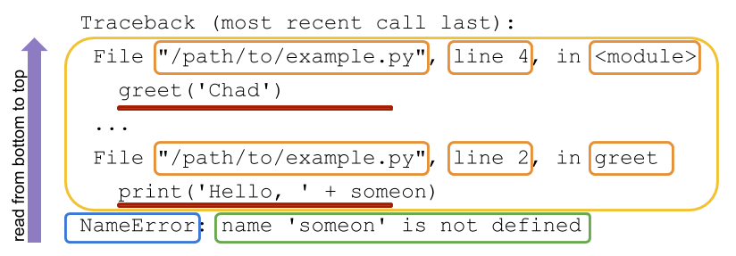
Reading a stack trace
Notes:
Image credit: https://realpython.com/python-traceback/

Slide 42
Print debugging
One debugging technique is print debugging
This involves calling print on variables/values of interest throughout your program to determine where the program is going wrong
In your assignments, you can do this by prefixing your print statements with 'DEBUG:' so that the OkPy autograder doesn't autofail you
>>> from math import sqrt
>>> def quadratic_formula_positive(a, b, c):
… discriminant = b * 2 - 4 * a * c
… print("DEBUG: discriminant is", discriminant)
… temp = (-b + sqrt(discriminant)) / (2 * a)
… print("DEBUG: temp is", temp)
… return temp
>>> quadratic_formula_positive(1, 2, 3)

Slide 43
Assert statements
Why debug when you can prevent bugs instead? → Defensive programming
One defensive programming technique is to use assert statements to programmatically verify your assumptions. If the assumption is False, an AssertionError is raised (with an optional message you provide).
>>> def divide(a, b):
… assert b != 0, 'divisor cannot be 0'
… return a / b
>>> divide(5, 0)
Traceback (most recent call last):
File "<python-input-1>", line 1, in <module>
divide(5, 0)
~~~~~~^^^^^^
File "<python-input-0>", line 2, in divide
assert b != 0, 'divisor cannot be 0'
^^^^^^
AssertionError: divisor cannot be 0

